Slide 1




Applied Data Analysis (CS401)
Lecture 7
Learning from data:
Supervised learning
1 Nov 2023
Robert West
Notes:
2021: 95 minutes (15-min break; skipped poll)
2022: 92 minutes (13-min break)
2023: 90 minutes (11-min break)

Slide 2
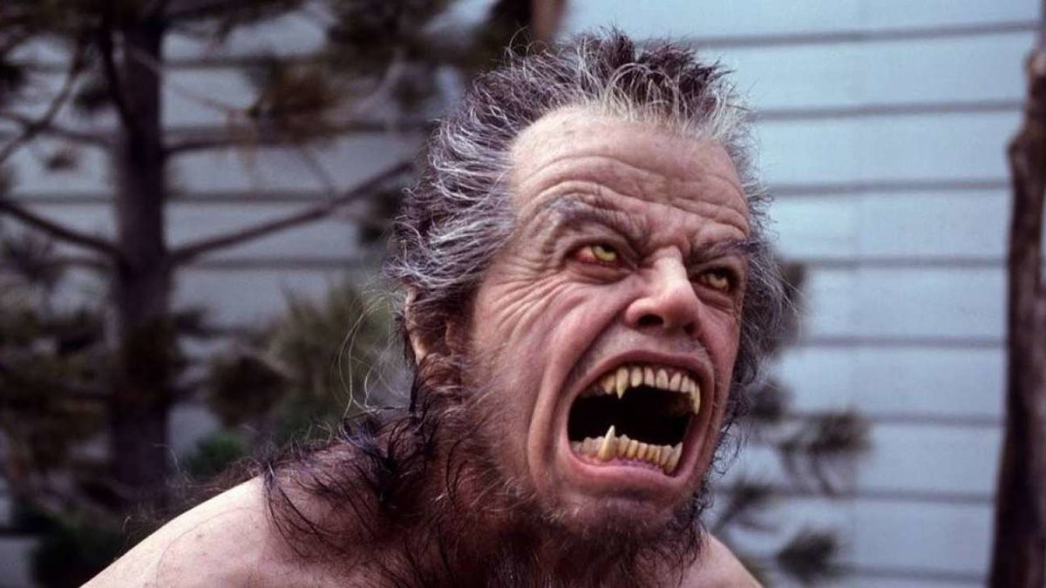
Annowwwwwncements
Happy (belated) Halloween!
Homework H1 is being graded. Feedback to be released next week.
Project milestone P2 due on Fri 17 Nov
Friday’s lab session: two parallel tracks:
Quiz 6
Track 1: exercise on supervised learning (in BCH 2201)
Track 2: project office hours (on Zoom)
Logistics: see Ed post
Do come and ask for feedback – everyone will win!

Slide 3
Feedback
Give us feedback on this lecture here: https://go.epfl.ch/ada2023-lec7-feedback
What did you (not) like about this lecture?
What was (not) well explained?
On what would you like more (fewer) details?
Where is Pumpkin Pete?
…

Slide 4
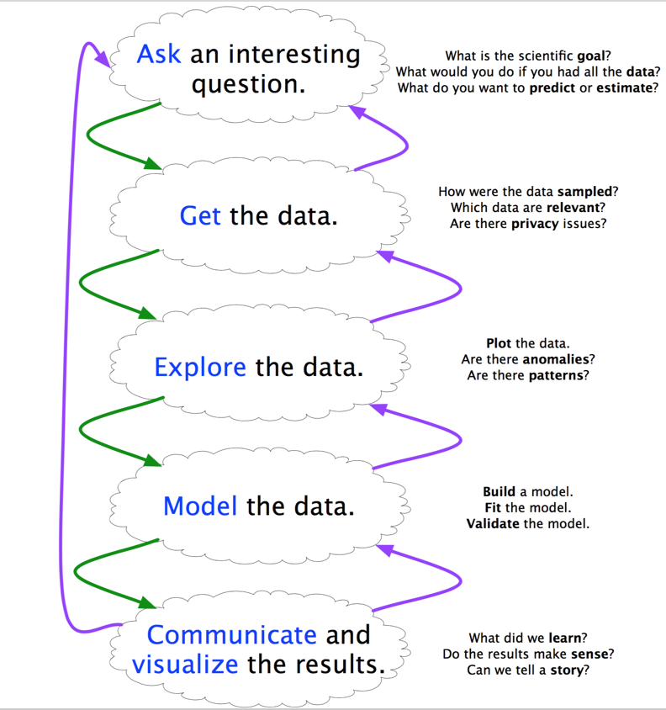
Why ML as part of data science?
ML can facilitate most steps of the data analysis cycle
But stay critical: “Can I trust my ML model?”
Notes:
Getting the data: automatic labeling/extraction
Exploring/communicating: viz, e.g., 2D embedding
Model: e.g., weight inspection as in regression analysis (lec 5)
Ask an interesting Q: e.g., from my own lab: “Can the success of a news headline be predicted from the text of the headline?”
Also: if you’ve understood sth only one way, you haven’t understood it at all (Minsky) → don’t worry if you’ve seen some of this before, e.g., in an ML class

Slide 5
Machine learning
Supervised: We are given input/output pairs (X, y) (a.k.a. “samples”) that are related via a function y = f(X). We would like to “learn” f, and evaluate it on new data. Types:
Discrete y (class labels): “classification”
Continuous y: “regression” (e.g., linear regression)
Unsupervised: Given only samples X of the data, we compute a function f such that y = f(X) is a “simpler” representation.
Discrete y (cluster labels): “clustering”
Continuous y: “dimensionality reduction”
Notes:
(running example: images of animals)
Supervised/discrete: is this a cat, dog, or cow?
Supervised/continuous: how much does this animal weigh?
Unsupervised/discrete: group these images, such that animals of the same species land in the same group.
Unsupervised/continuous: turn each of these images into a 3D vector.
…
Many shades of gray in between (e.g., “semi-supervised”, RL)

Slide 6
Machine learning: examples
Supervised (lecture 7, i.e., today):
Is this image a cat, dog, or cow?
How would this user rate that restaurant?
Is this email spam?
Is this blob on a telescope image a supernova?
Unsupervised (lecture 9):
Cluster handwritten digit data into 10 classes
What are the top 20 topics in Twitter right now?
Find the best 2D visualization of 1000-dimensional data
Notes:
(some more examples, can skip after already having given examples on previous slide)
Unsupervised in 2 weeks
In between: one lec about more practical aspects of ML

Slide 7
Machine learning: techniques
Supervised learning:
k-NN (k nearest neighbors)
Tree-based models: decision trees, random forests
Linear + logistic regression
Naïve Bayes
Support vector machines
Supervised neural networks
etc.
Unsupervised learning:
Clustering
Dimensionality reduction: topic modeling, matrix factorization (PCA, SVD, word2vec)
Hidden Markov models (HMM)
etc.
Today
(particularly in light of bias/variance tradeoff)
Lectures 9, 10, 11
Notes:
(Go fast)
Also today: use those techniques to explain a fundamental concept in ML/stats: bias/variance tradeoff

Slide 8
Intro to supervised learning:
k nearest neighbors (k-NN)

Slide 9
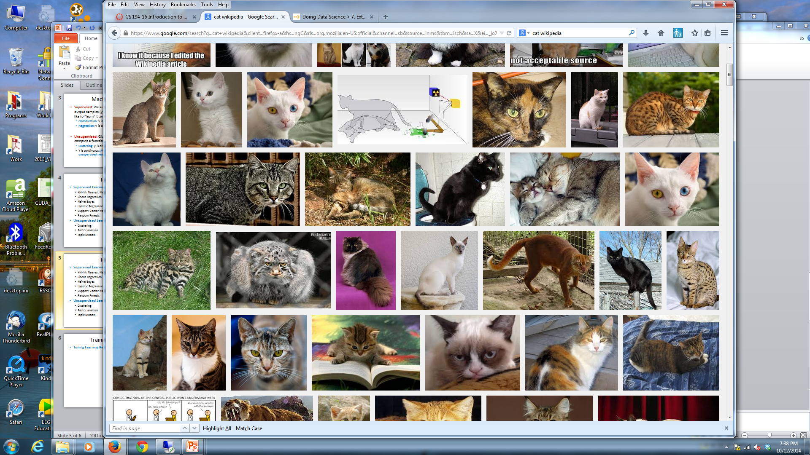
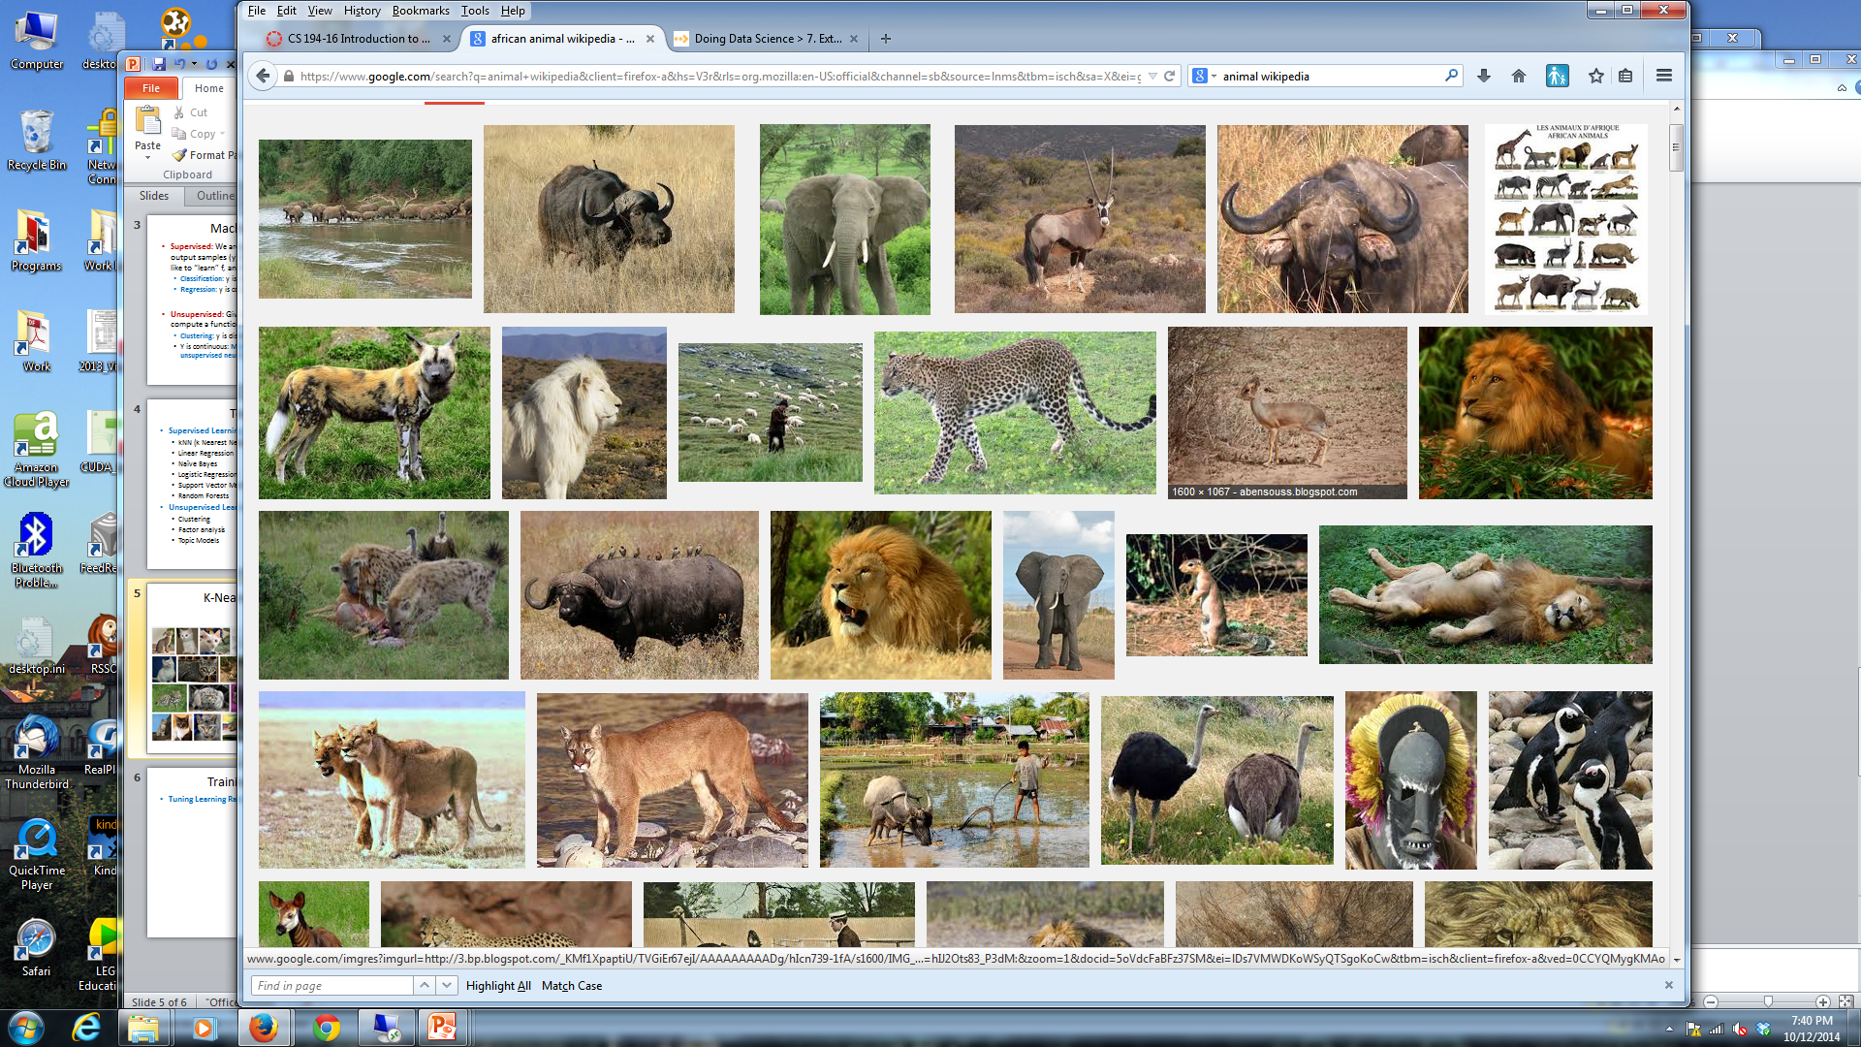
k nearest neighbors (k-NN)
Given a query item: Find k closest matches in a labeled dataset ↓
Notes:
I explain k-NN in a nutshell with the example of image classification (but it works for many other kinds of data as well)
You’re given a query item, such as this image, and you’d like to determine what kind of thing is shown in the image
You also have a dataset of images for which you already know what’s shown in each image
k-NN works like this: it first finds the k images in the labeled dataset that are most similar to the query image
(p.t.o.)

Slide 10
k nearest neighbors (k-NN)
Given a query item: Return the most Find k closest matches frequent label
in a labeled dataset ↓ among the k
Notes:
If k=3, we might get these 3 images on the right

Slide 11
k nearest neighbors (k-NN)
k = 3 votes for “cat”
Notes:
And we can now simply find the most frequent label in the retrieved images and return it as the label for the query image
Here all 3 images are labeled as cats, so the vote is unanimous, and we label the query as a cat

Slide 12
Properties of k-NN
The data is the model
No training needed.
Conceptually simple algorithm.
Accuracy generally improves with more data.
Usually need data in memory, but can also be run from disk.
Minimal configuration:
Only one parameter: k (number of neighbors)
But two other choices are also important:
Similarity metric
Weighting of neighbors in voting (e.g. by similarity)
Notes:
Disk: Need to compare query point to all other data points
Unless data is smartly indexed

Slide 13
k-NN flavors
Classification:
Model is y = f(X), y is from a discrete set (labels).
Given X, compute y = majority vote of the k nearest neighbors.
Can also use a weighted vote* of the neighbors.
Regression:
Model is y = f(X), y is a real value.
Given X, compute y = average value of the k nearest neighbors.
Can also use a weighted average* of the neighbors.
* Weighting function is usually the similarity.

Slide 14
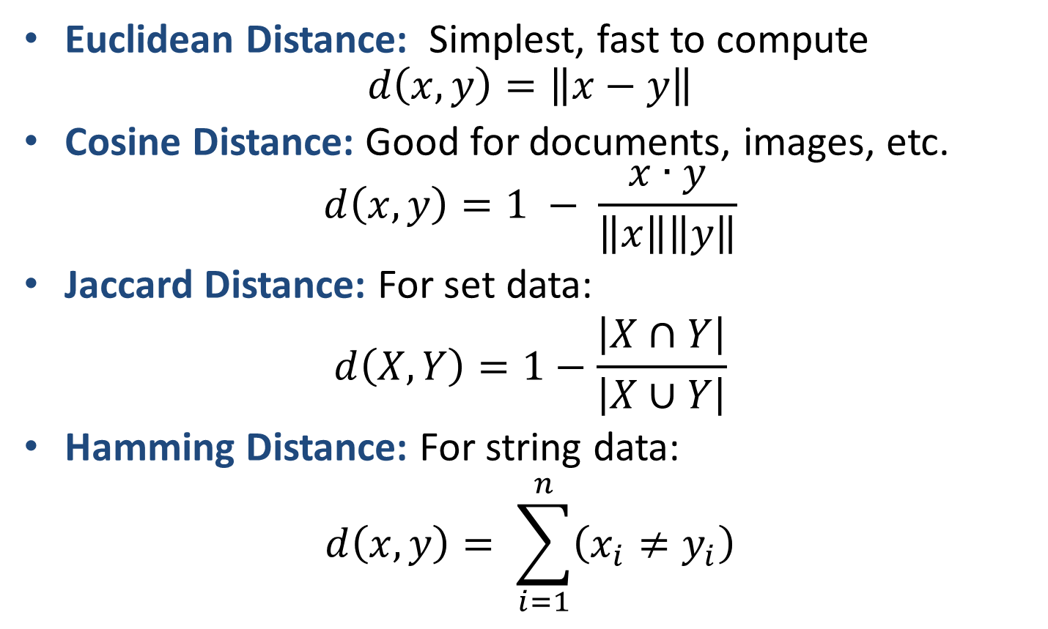
k-NN distance (opposite of similarity) measures
Notes:
I introduce these in the context of k-NN, but they are relevant across all of ML and data mining

Slide 15
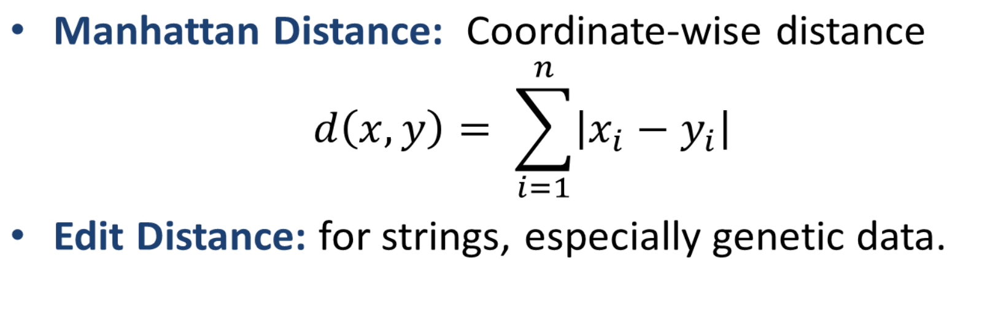
k-NN distance (opposite of similarity) measures

Slide 16
stack.push(kNN)
Notes:
Asking you to push k-NN on your mental stack
Using k-NN as a starting point for an excursion into a fundamental concept relevant to all of stats/ML: bias/variance tradeoff

Slide 17
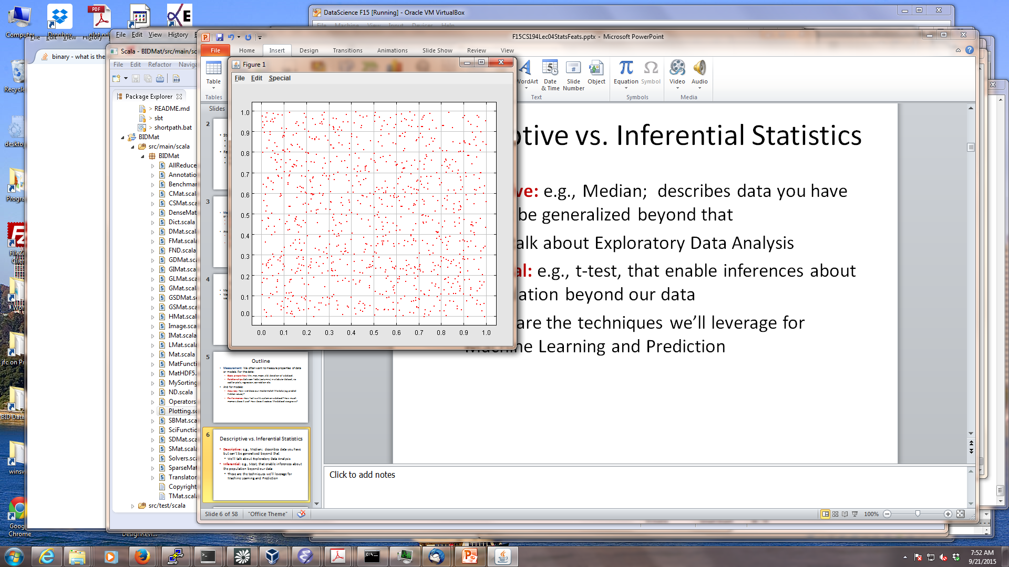
Predicting from samples
Most datasets are samples from a (maybe infinite) population.
We are most interested in models of the population, but we only have access to a sample (blue points) from the population.
For a dataset consisting of pairs (X, y):
features X, label y,
we aim to find the true model f:
y = f(X).
We train on a training sample D and denote the fitted model as f_{D}
Notes:
Regardless how complex the relationship between X and y, there is an f connecting the two; in the worst case: (infinitely large) lookup table
…
f_D is an estimate of the true f

Slide 18
Bias and variance
Given a random training sample D, obtain model f_{D}
For a new data point (X, y), prediction is f_{D}(X)
(Squared) error = E[(f_{D}(X) – y)²] (E is expectation over D!)
Fact: error can be decomposed into two parts (derivation)
Error² = Bias² + Variance
Bias = E[f_{D}(X) – y]
Variance = E[(f_{D}(X) – E[f_{D}(X)])²]
Notes:
Randomness comes from choice of D; consider X fixed for now
Intuitive explanation of bias and variance: see next slide

Slide 19
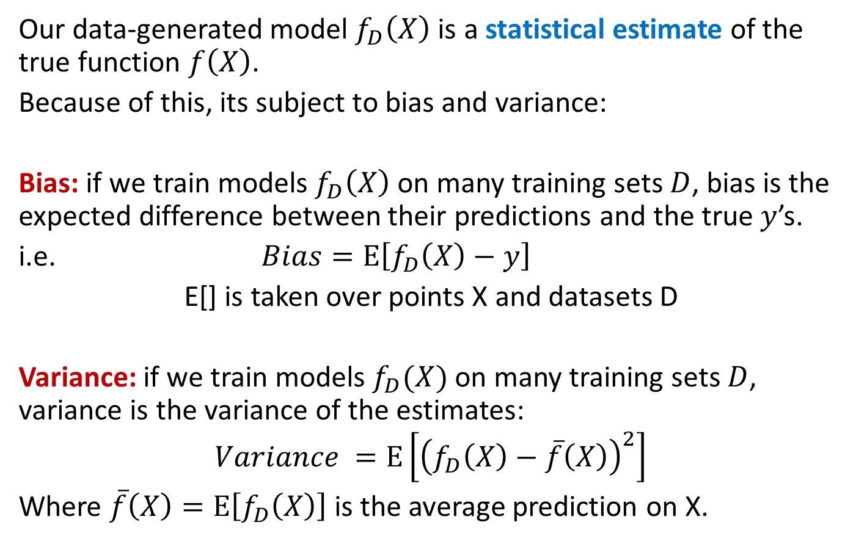
Bias and variance
Notes:
Variance: note that it doesn’t depend on true y
Previous slide: considered a fixed testing data point (X,y); expectation only over training set D
Now also take expectation over testing set {(X,y)}

Slide 20
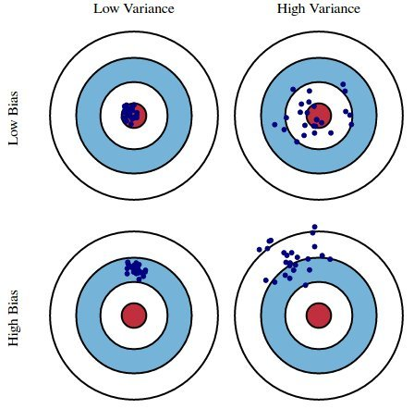
Consider a fixed testing point (X, y)
not seen during training
f_{D1}(X)
f_{D2}(X)
…
true y = f(X)
“Full” bias/variance: average this picture over all testing points (X, y)
Notes:
Train model on many different random training sets D
Every point: predicted y for one training set D (for sake of picture, y is 2D here, though usually 1D)
Bias = average closeness to center
Variance = dispersion of predictions

Slide 21
Bias/variance tradeoff
Since Error² = Bias² + Variance, there is a tradeoff, usually modulated via model complexity:
Complex models (many parameters) usually have lower bias, but higher variance.
Simple models (few parameters) have higher bias, but
lower variance.
Notes:
Example: p.t.o.

Slide 22
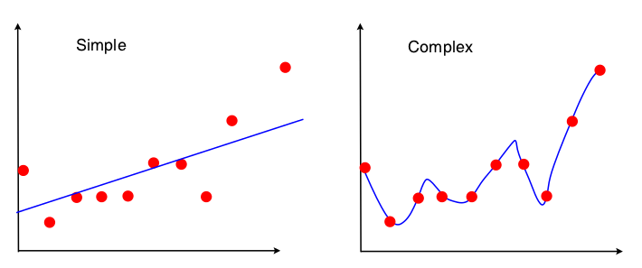
Bias/variance tradeoff
Example: A linear model can only fit a straight line. A high-degree polynomial can fit a complex curve. But the polynomial will fit the individual training sample, rather than the full population. Its shape can vary from sample to sample, so it has high variance.
y
y
X
X
Notes:
Move one red dot
Won’t change straight line too much
But might change polynomial drastically

Slide 23
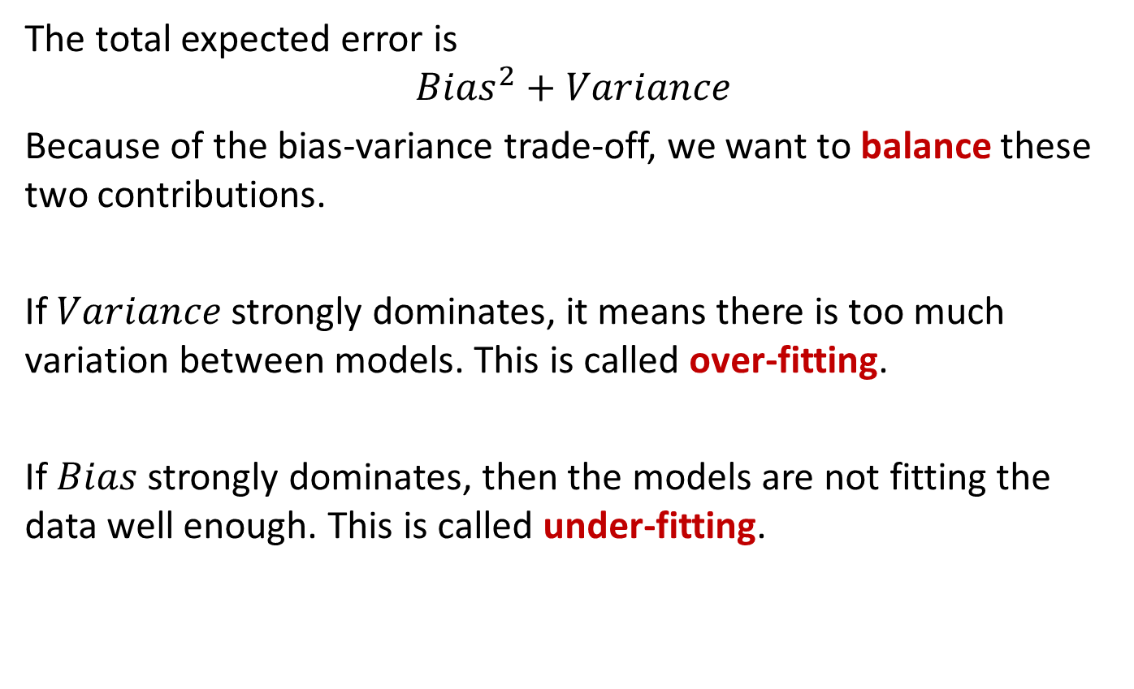
Bias/variance tradeoff
Notes:
It’s usually easy to make a model w/ low bias (memorize the training data) or w/ low variance (always predict fixed constant)
Goal: find optimal tradeoff, where both are reasonably low

Slide 24
kNN = stack.pop()

Slide 25
Choosing k for k nearest neighbors
We have a bias/variance tradeoff:
Small k → ?
Large k → ?
THINK FOR A MINUTE:
When k increases, how do bias and variance change?
(Feel free to discuss with your neighbor.)
Notes:
(don’t cheat by looking at next slides, please)

Slide 26
Choosing k
Small k → low bias, high variance
Large k → high bias, low variance
Assume the real data follows the blue curve, with zero-mean additive noise. Red points are a data sample.
y
y = f(X)
X
Notes:
Particularly simple case: X is 1-D
Ex.: Consider bias and variance for fixed X
To get full bias and variance: need to take expectation over all X

Slide 27
Choosing k
Small k → low bias, high variance
Large k → high bias, low variance
y
Points from original sample
k = 1
Bias = average of this offset
y
y = f(X)
X
X
Notes:
Whenever I sample a new red dataset, I get a new nearest neighbor, and thus a new predicted y
Bias = average distance of predicted y (height of green point) from true y (height of blue line)
(Animation: click back and forth b/w this slide and next)

Slide 28
Choosing k
Small k → low bias, high variance
Large k → high bias, low variance
y
Points from a different sample
k = 1
Bias = average of this offset
y
y = f(X)
X
X
Notes:
Low bias (close to blue curve), on average
But high variance: prediction varies a lot across samples

Slide 29
Choosing k
Small k → low bias, high variance
Large k → high bias, low variance
y
k = 8
Bias = average of this offset
y
y = f(X)
X
X

Slide 30
Choosing k
Small k → low bias, high variance
Large k → high bias, low variance
y
k = 8
Bias = average of this offset
y
y = f(X)
X
X
Notes:
Larger bias (further off from blue line)
But smaller variance: consistent prediction across samples

Slide 31

Choosing k in practice
Use leave-one-out (LOO) cross-validation:
Split: Break data into train and test subsets, e.g. 80–20 % random split.
Predict: For each point in the training set, predict using the k nearest neighbors from the set of all other points in training set. Measure the LOO error rate (classification) or squared error (regression).
Tune: Try different values of k, and use the one that gives minimum leave-one-out error.
Evaluate: Measure error on the test set to quantify performance.

Slide 32


Commercial break
Trick or data!
Data is our candy.

Slide 33
Decision trees

Slide 34
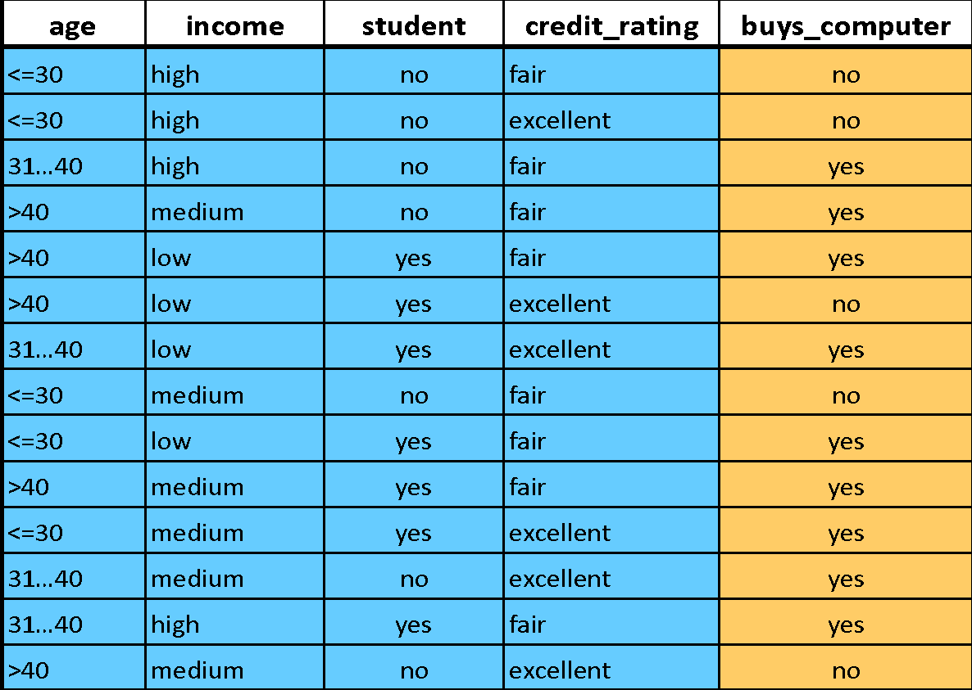
Decision trees: example
Age?
<=30
>40
31..40
Student?
yes
Credit rating?
no
yes
excellent
fair
no
yes
no
yes
Notes:
Goal: predict if someone will buy a computer, based on …
A flow chart like this, called a decision tree, can give you a sequence of rules to apply in order to make that prediction (p.t.o.)

Slide 35
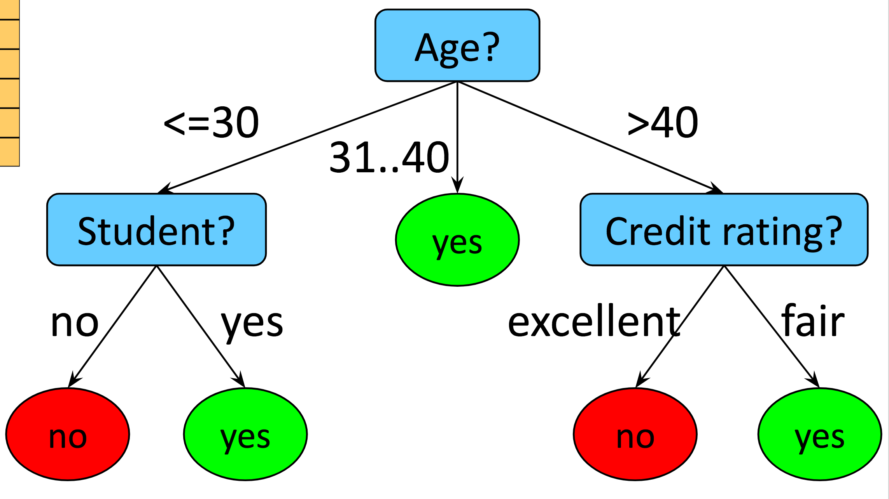
Decision trees
Model: Flow-chart-like tree structure
Nodes are tests on a single attribute
Branches are attribute values of parent node
Leaves are marked with class labels
Goal: Find decision tree that maximizes classification accuracy on given dataset
Optimization:
NP-hard
Heuristic: greedy top-down tree construction + pruning

Slide 36
Decision tree induction
Tree construction (top-down divide-and-conquer strategy)
At the beginning, all training samples belong to the root
Examples are partitioned recursively based on selected “most discriminative” attributes (partitioning data into most homogeneous subsets)
Discriminative power based on information gain (in ID3 and C4.5 algorithms) or Gini impurity (in CART algorithm)
Partitioning stops if
All samples belong to the same class → assign the class label to the leaf
There are no attributes left → majority voting to assign the class label to the leaf

Slide 37
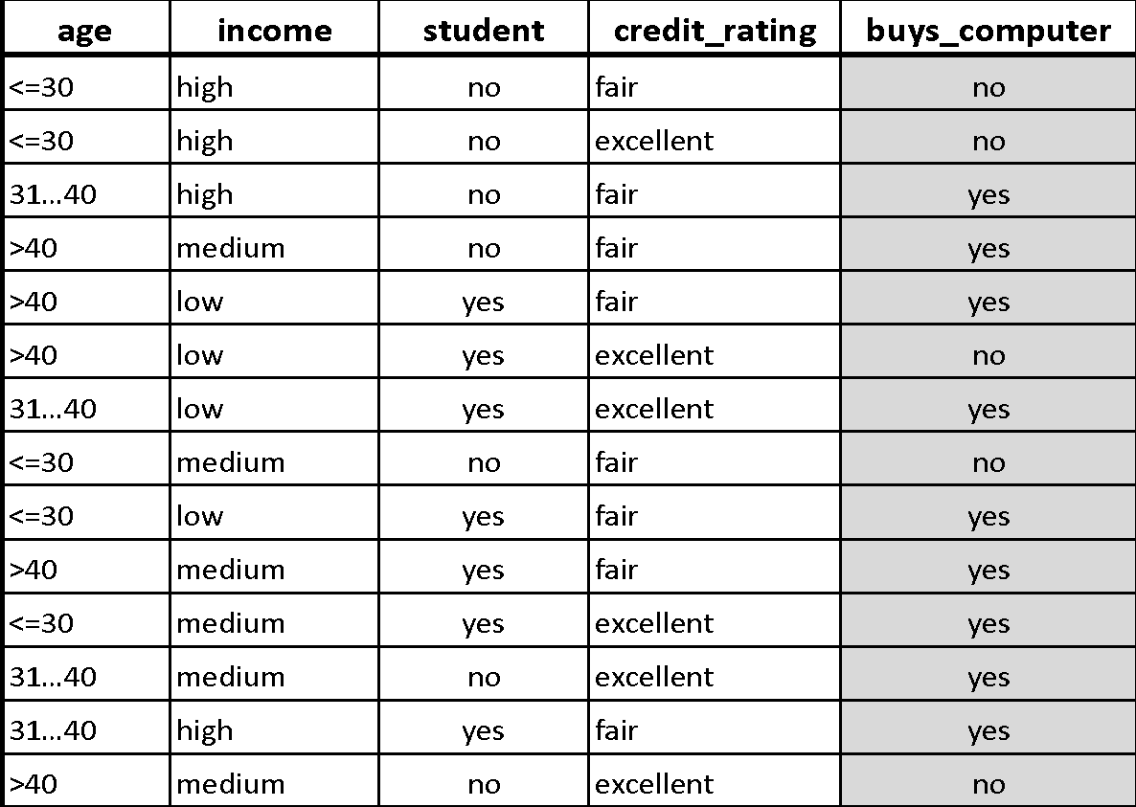
Decision tree induction
Age?
<=30
>40
31..40
yes

Slide 38
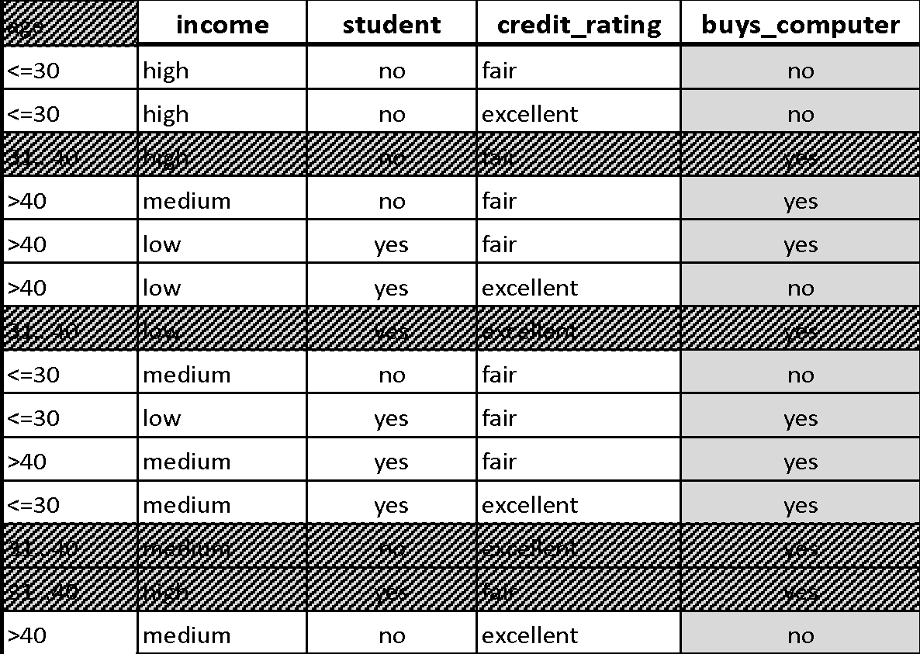
Decision tree induction
Age?
<=30
>40
31..40
Student?
yes
no
yes
no
yes

Slide 39
Decision tree induction
Age?
<=30
>40
31..40
Student?
yes
Credit rating?
no
yes
excellent
fair
no
yes
no
yes

Slide 40
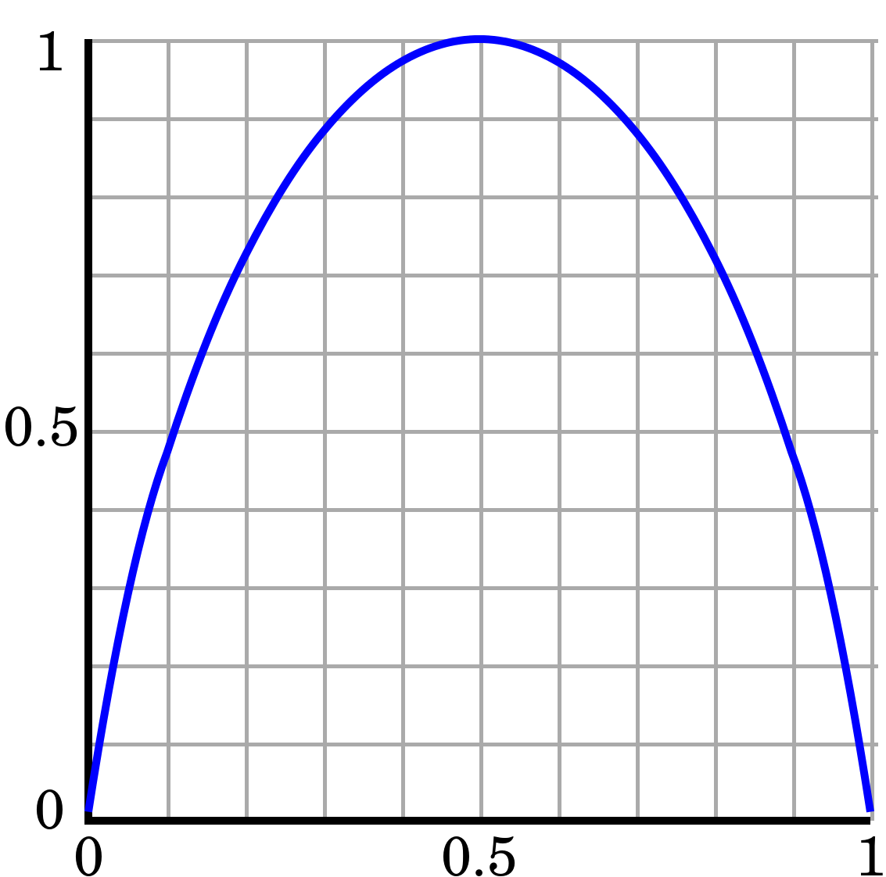
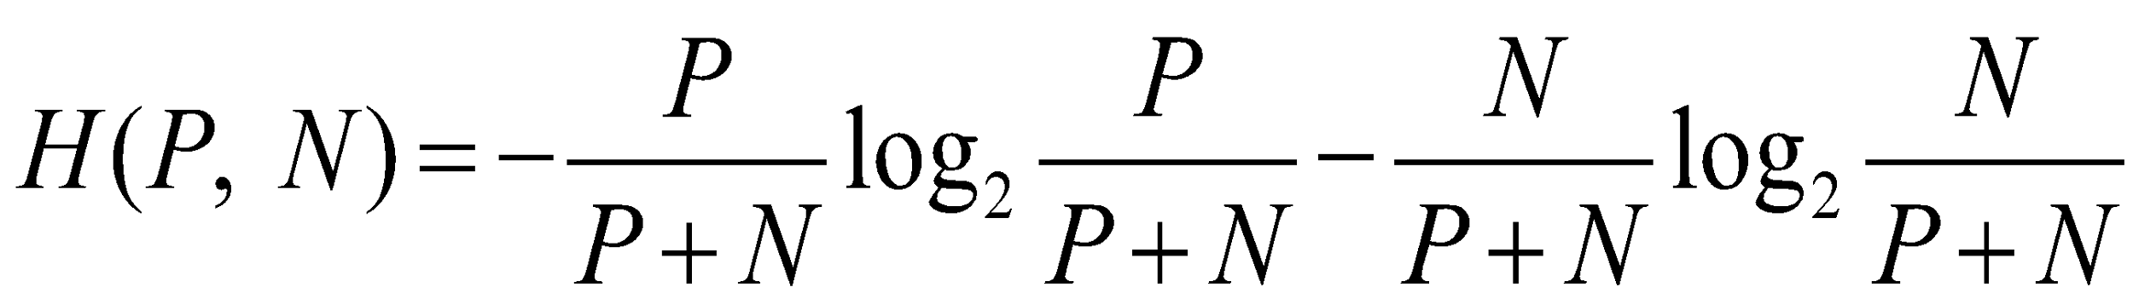
Attribute selection
For a given branch in the tree, the set of samples S to be classified has P positive and N negative samples
The amount of entropy in the set S is
Note that:
If P = 0 or N = 0: H(P, N) = 0 → no uncertainty
If P = N: H(P, N) = 1 → maximum uncertainty
H(P, N)
P/(P+N)
Notes:
log 0 = 0 by convention
So strategy: select attribs such that, after splitting, datasets associated with child nodes have low entropy

Slide 41
Attribute selection
H_{S} = H(9, 5) = 0.94
Age [<=30] H(2, 3) = 0.97 Income [high] H(2, 2) = 1
Age [31...40] H(4, 0) = 0 Income [med] H(4, 2) = 0.92
Age [>40] H(3, 2) = 0.97 Income [low] H(3, 1) = 0.81
Student [yes] H(6, 1) = 0.59 Rating [fair] H(6, 2) = 0.81
Student [no] H(3, 4) = 0.98 Rating [exc] H(3, 3) = 1
Notes:
14 = 9 + 5 data points
H_S is entropy before splitting
Splitting by age creates 3 subsets, w/ entropies 0.97, 0, 0.97; etc. for other attribs

Slide 42
Attribute selection
H_{S} = H(9, 5) = 0.94
H_{Age} = p([<=30]) ∙ H(2, 3) + p([31...40]) ∙ H(4, 0) + p([>40]) ∙ H(3, 2) =
= 5/14 ∙ 0.97 + 4/14 ∙ 0 + 5/14 ∙ 0.97 = 0.69
H_{Income} = p([high]) ∙ H(2, 2) + p([med]) ∙ H(4, 2) + p([low]) ∙ H(3, 1) =
= 4/14 ∙ 1 + 6/14 ∙ 0.92 + 4/14 ∙ 0.81 = 0.91
H_{Student} = p([yes]) ∙ H(6, 1) + p([no]) ∙ H(3, 4) = 7/14 ∙ 0.59 + 7/14 ∙ 0.98 = 0.78
H_{Rating} = p([fair]) ∙ H(6, 2) + p([exc]) ∙ H(3, 3) = 8/14 ∙ 0.81 + 6/14 ∙ 1 = 0.89
Notes:
Compute expected entropy for each attribute (weighted average over entropies associated w/ values of the attrib)
Pick attribute w/ lowest expected entropy

Slide 43
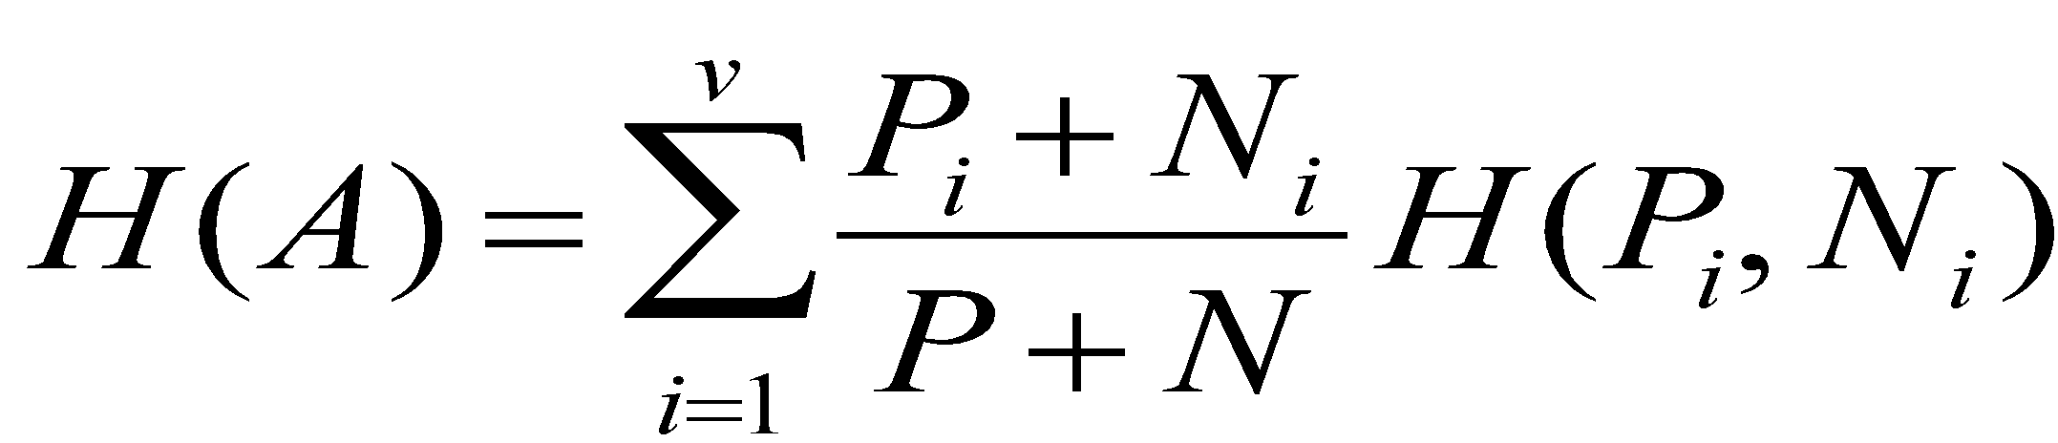
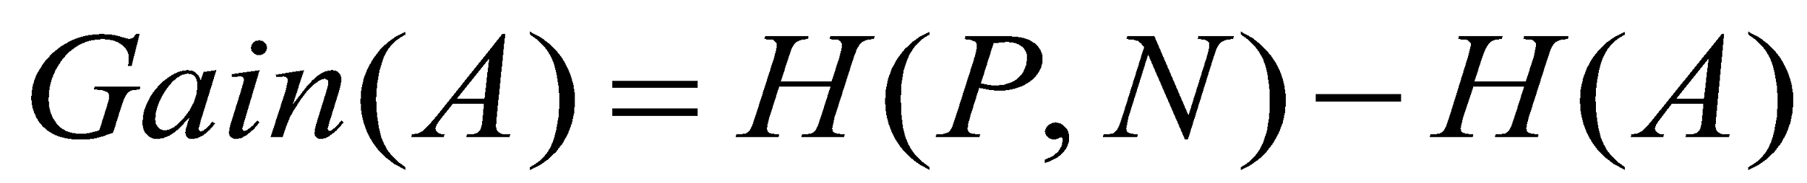
Attribute selection
Attribute A partitions S into S₁, S₂, ... S_{v}
Entropy of attribute A is
The information gain obtained by splitting S using A is
Gain(Age) = 0.94 – 0.69 = 0.25
Gain(Income) = 0.94 – 0.91 = 0.03
Gain(Student) = 0.94 – 0.78 = 0.16
Gain(Rating) = 0.94 – 0.89 = 0.05
← split on age
Notes:
In a nutshell: …
Info gain: entropy before splitting, minus expected entropy after splitting
Minimizing exp entr after splitting == maximizing info gain

Slide 44
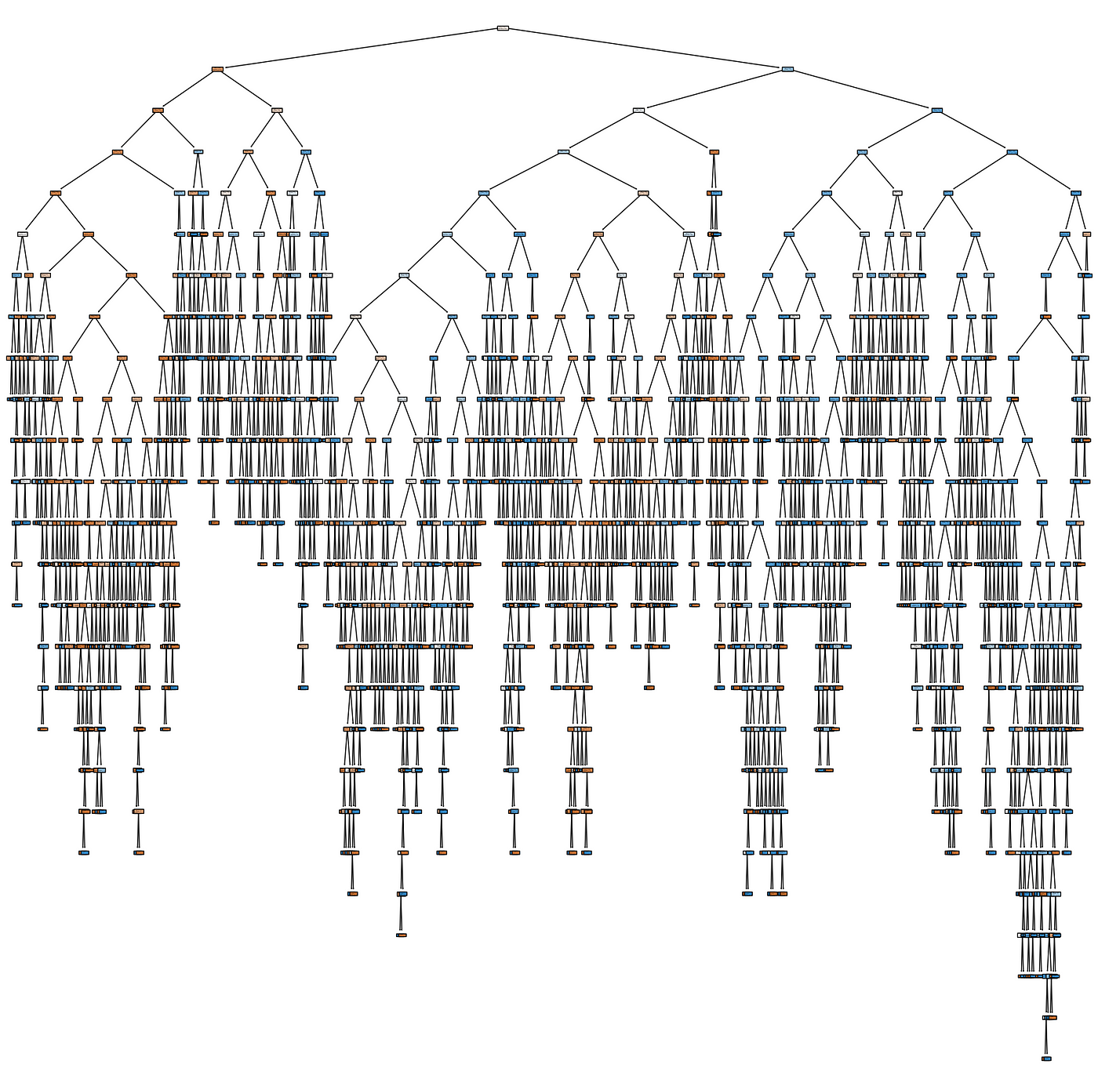
Pruning
The construction phase does not filter
out noise → overfitting
Many possible pruning strategies
Stop partitioning a node when the corresponding number of samples assigned to a leaf goes below a threshold
Bottom-up cross validation: Build the full tree and replace nodes with leaves labeled with the majority class if classification accuracy on a validation set (not seen during training!) does not get worse this way
Notes:
(can fit any training set perfectly: one leaf for each combo of feature values)

Slide 45
Comments
Decision trees are an example of a classification algorithm
Many other out there (k-NN, naive Bayes, SVM, neural networks, logistic regression, random forests ...)
Maybe not the best one ...
Sensitive to small perturbation in the data (high variance)
Tend to overfit
Non-incremental: Need to be re-trained from scratch if new training data becomes available

Slide 46

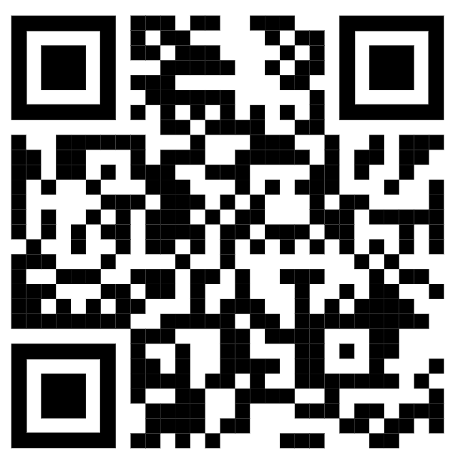
Decision tree models
As tree depth increases, how do bias and variance change? (Hint: think about k-NN)
POLLING TIME
Scan QR code or go to https://web.speakup.info/room/join/66626
Notes:
(Please don’t cheat by looking at next slide)
As decision tree depth increases …
(A) ... bias increases, variance decreases
(B) ... bias decreases, variance increases
(C) ... both bias and variance increase
(D) ... both bias and variance decrease

Slide 47
Decision tree models
As tree depth increases, bias decreases and variance generally increases. Why? (Hint: think about k-NN)
Bias decreases with tree depth
Variance increases with tree depth
Notes:
More depth → check more properties of data points → higher chance of ending up in a different leaf when using different training data
Small depth → many different data points end up in same leaf → can’t discriminate well → high error
Next: how to improve bias and variance by using more than a single tree

Slide 48
Ensemble methods
Are, metaphorically, like “democratic” machine learning algorithms:
Take a collection of simple or weak learners
Combine their results to make a single, better learner
Types:
Bagging: train learners in parallel on different samples of the data, then combine by voting (for discrete output) or by averaging (for continuous output).
Boosting: train learner again, but after filtering/weighting samples based on output of previous train/test runs.
Stacking: combine outputs from various models using a second-stage learner (e.g., linear regression).
Notes:
Bagging = bootstrap aggregating
Stacking: combined models can even be of very different type

Slide 49
Random forests
Grow K trees on datasets sampled from the original dataset (size N) with replacement (bootstrap samples), p = number of features.
Draw K bootstrap samples of size N
Grow each decision tree by selecting a random set of m out of p features at each node and choosing the best feature to split on.
At testing time, aggregate the predictions of the trees (most popular vote, or average) to produce the final class (example of bagging).
Typically m might be e.g. sqrt(p), but can be smaller.
Notes:
Feature sampling also called “dropout” in NNs
https://en.wikipedia.org/wiki/Random_forest

Slide 50
Random forests
Principles: we want to take a vote between different learners so we don’t want the models to be too similar. The following two criteria ensure diversity in the individual trees:
Draw K bootstrap samples of size N:
Each tree is trained on different data.
Grow a decision tree by selecting a random set of m out of p features at each node, and choosing the best feature to split on.
Corresponding nodes in different trees (usually) can’t use the same feature to split on.

Slide 51
Random forests
Very popular in practice, probably the most popular classifier for dense data (up to a few thousand features)
Easy to implement (simply train many normal decision trees)
Easy to parallelize
Needs many passes over the data – at least the max depth of the trees (<< boosted trees though, cf. next slide)

Slide 52
Boosted decision trees
A more recent alternative to random forests (RF) [good intro here]
In contrast to RF, whose trees are trained independently by bagging, BDT trees are trained sequentially by boosting: Each tree is trained to predict (“correct”) residual errors of previous trees (→ bias reduction).
Final prediction: sum of predictions made by individual trees.
Both RF and boosted trees can produce very high-quality models. Superiority of one method or the other is dataset-dependent.
Resource requirements are very different as well, so it’s actually non-trivial to compare the methods.
Notes:
So you have now seen examples of both bagging (RF) and boosting (BDT)

Slide 53
Random forests vs. boosted trees
The “geometry” of the methods is very different:
Random forests use 10’s of deep, large trees:
Depth 10-30
…
100k’s of nodes
Bias reduction
through depth
10’s of trees
Variance reduction through the ensemble aggregate

Slide 54
Random forests vs. boosted trees
The “geometry” of the methods is very different:
Boosted decision trees use 1000’s of shallow, small trees:
…
Depth 4–8
100’s of nodes
1000’s of trees
Bias reduction through boosting – variance already low

Slide 55
Random forests vs. boosted trees
RF training embarrassingly parallel, can be very fast
Evaluation of trees (runtime) also much faster for RFs
Depth 10-30
…
100k’s of nodes
10’s of trees
…
Depth 4-8
100’s of nodes
1000’s of trees

Slide 56
For your personal perusal: “A visual introduction to machine learning”
http://www.r2d3.us/visual-intro-to-machine-learning-part-1/
Notes:
(Lecture of 2019-10-24 ended here.)

Slide 57
Linear and logistic regression

Slide 58
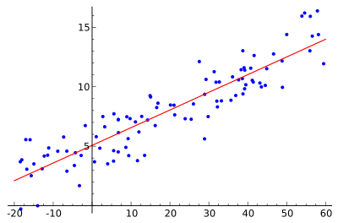
Linear regression
Your good friend from lecture 5 on regression analysis
Goal: find the “best” line (linear function y = f(X)) to explain the data
y
X
Notes:
If more than 1 feature: (hyper)plane

Slide 59
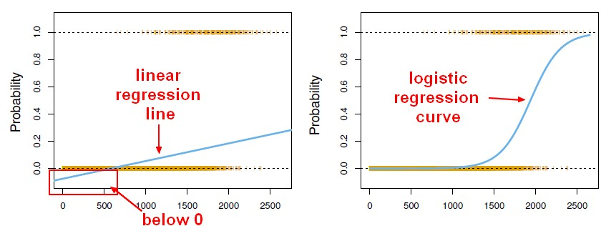
How to model binary events?
E.g., X: student features; y: did student pass ADA?
Desired output: f(X) = probability of passing ADA, given feats X
Problem with linear regression: f(X) can be below 0 or above 1
Notes:
E.g., 1D feature X = minutes spent studying

Slide 60
Logistic regression
Bad!
Want this!
Trick: don’t deal with probabilities, which range from 0 to 1, but with log odds, which range from –∞ to +∞
Probability y ⇔ odds y/(1–y) ⇔ log odds log[y/(1–y)]
Model log odds as a linear function of X
Notes:
Odds range from 0 to +inf
½ as far from 0 as 2 is from 0

Slide 61
Logistic regression
Model log odds as a linear function of X
β^{T}X = log[y/(1–y)]
Solve for y: y = 1 / (1 + exp(–β^{T}X))
Finding best model β via maximum likelihood:
Don’t use square loss as in linear regression (where y is assumed to be generated from Normal distribution)
Use cross-entropy loss instead (y assumed to be generated from Bernoulli distribution, i.e., biased coin)
“sigmoid”
Notes:
(Skip model fitting, just say this:)
I also added something about how to fit a log reg model
But more for completeness; not so crucial for the purposes of ADA
See ML class

Slide 62
Overfitting
The more features the better?
No!
More features mean less bias, but more variance
Overfitting
Carefully selected features can improve model accuracy
E.g., keep features that correlate with the label y
Forward/backward feature selection
Regularization (e.g., penalize norm of weight vector)
More on such practical aspects: next lecture (“applied ML”)
Notes:
To set the stage for next week: …
High variance because predictions for same data point will vary a lot for different training datasets
Low bias because overprediction =~ underprediction

Slide 63
Feedback
Give us feedback on this lecture here: https://go.epfl.ch/ada2023-lec7-feedback
What did you (not) like about this lecture?
What was (not) well explained?
On what would you like more (fewer) details?
Where is Pumpkin Pete?
…

Slide 64
Criteria
Predictive performance (accuracy, AUC/ROC, precision, recall, F1-score, etc.)
Speed and scalability
Time to build the model
Time to use the model
In memory vs. on disk processing
Communication cost
Robustness
Handling noise, outliers, missing values
Interpretability
Understanding the model and its decisions (black box vs. white box)
Compactness of the model
Mobile and embedded devices
Notes:
When deciding which technique (e.g., from previous slide) to use, keep in mind:
There are many performance metrics
They may be completely different (tradeoffs, e.g., prec/rec)

Slide 65
k-NN and the curse of dimensionality
The curse of dimensionality refers to “weird” phenomena that occur in high dimensions (100s to millions) that do not occur in low-dimensional (e.g. 3-dimensional) space.
In particular data in high dimensions are much sparser (less dense) than data in low dimensions.
For k-NN, this means there are fewer points that are very close in feature space (very similar) to the point X whose y we want to predict.
Notes:
Why? Because volume (or num possible data points) grows exponentially with dimension
In fact, it starts getting weird already for d > 3

Slide 66
k-NN and the curse of dimensionality
From this perspective, it’s surprising that kNN works at all in high dimensions.
Luckily real data are not like random points in a high-dimensional cube. Instead they live in dense clusters and near much lower-dimensional surfaces.
Also, points can be very “similar” even if their Euclidean distance is large. E.g. documents with the same few dominant words are likely to be on the same topic (--> use different distance)

Slide 67
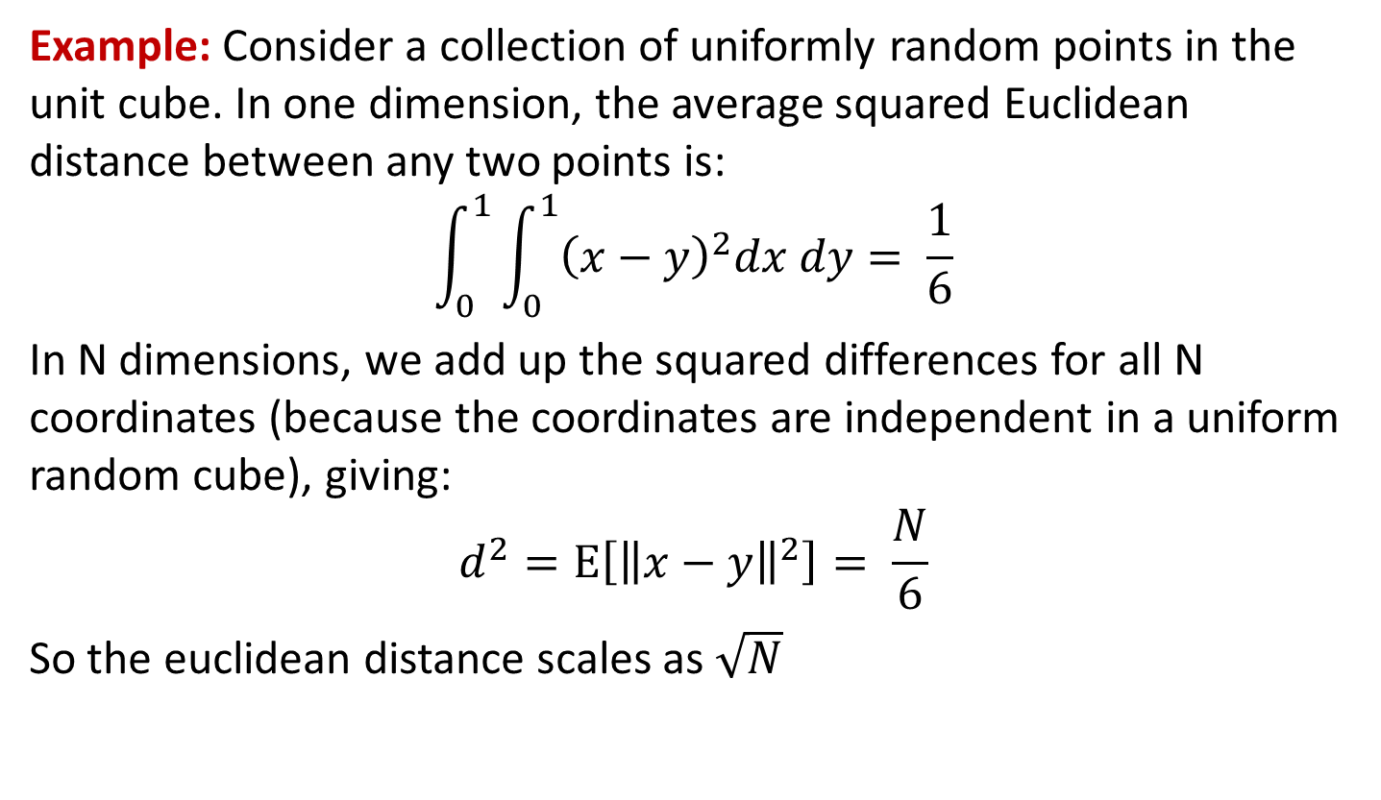
k-NN and the curse of dimensionality
Notes:
pythagoras

